Slide 1
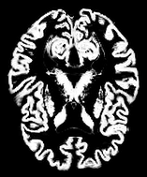
Sample Input Data
Type: Gray Matter (Segmented and normalized MRI Image)
Dimension: 189 * 157 pixels
No. of images: 500

Slide 2
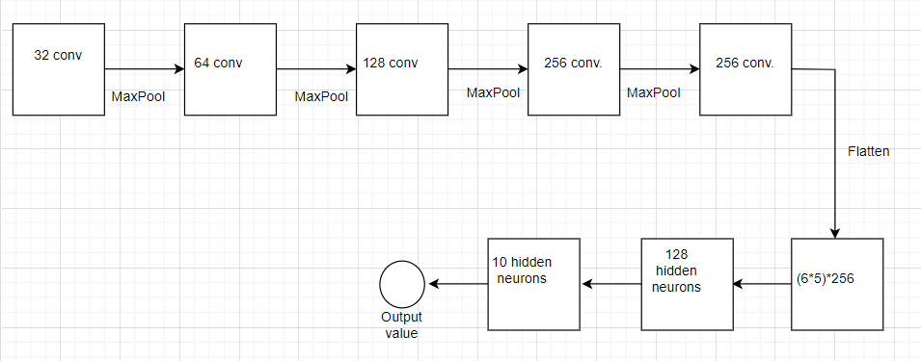
CNN Architecture

Slide 3
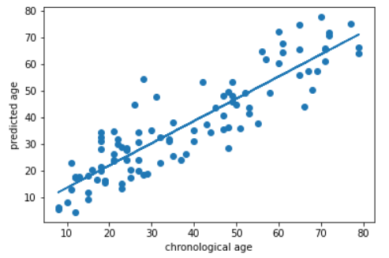
Chronological age Vs. Predicted age
Pearson R: 0.895
R² score: 0.7963
MAE: 2.4844 years
No. of test data: 100

Slide 4
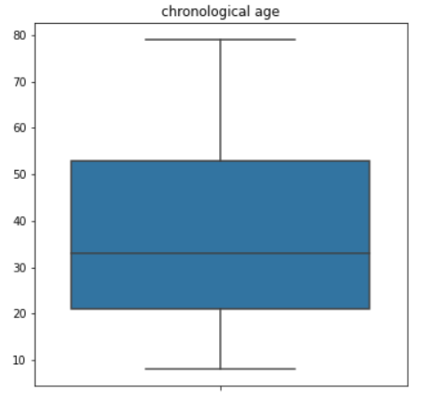
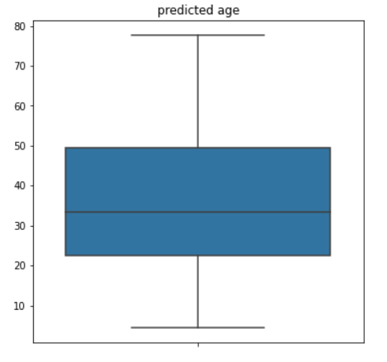

Slide 5
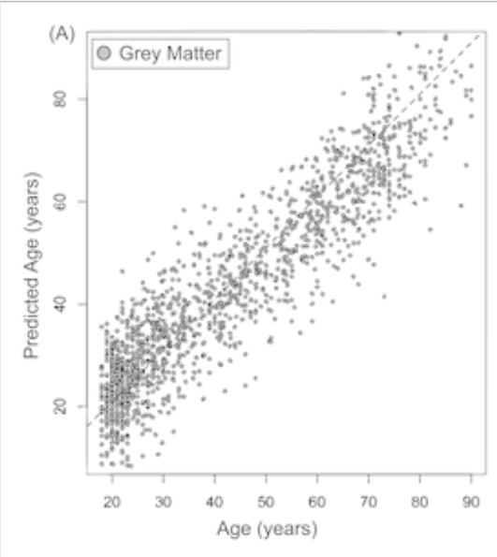
Related Research by James H. Cole et.al [1]
Machine Learning model: Gaussian Processes Regression
No. of training data: 1,600 approx.
Input data: Gray Matter MRI images
R score = 0.931
R² score = 0.867
MAE = 5.80 years

Slide 6
Possible measures to increase accuracy:
Increase the amount of input data,
Integration of fMRI images,
Integration of White Matter images, etc.

Slide 7
References:
[1] Cole, J.H., Leech, R., Sharp, D.J. and (2015), Prediction of brain age suggests accelerated atrophy after traumatic brain injury. Ann Neurol., 77: 571-581. https://doi.org/10.1002/ana.24367

